Slide 1
Java Training – Part 1
Trifan Alexandru
Full Stack Developer

Slide 2
General Structure
Java Introduction
Fitnesse Introduction
Fitnesse Fixture – Basics
Fitnesse Fixture – Write your own
Selenium – Automated Front-End Testing

Slide 3
Part 1 – Java Introduction
About Java
Object Oriented Programming
Collections
Maven – Build Manager
Communication Protocols (REST/SOAP/WS)
Live Coding - application

Slide 4
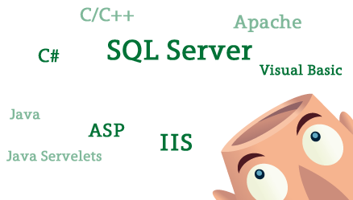
Before we start
CODING EXPERIENCE?

Slide 5
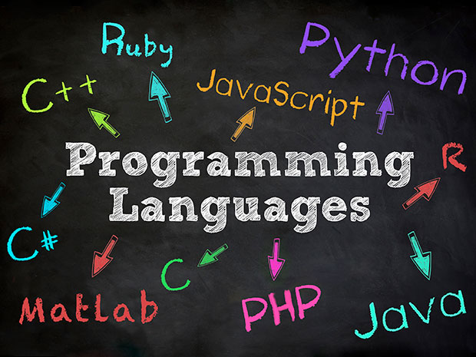

Java Introduction
1. JAVA!!!
2. C
3. C++
4. Python
5. C#
6. Javascript
High level language
Compiled language
Level 3 language
Enterprise
No 1 most used programming language 2015

Slide 6
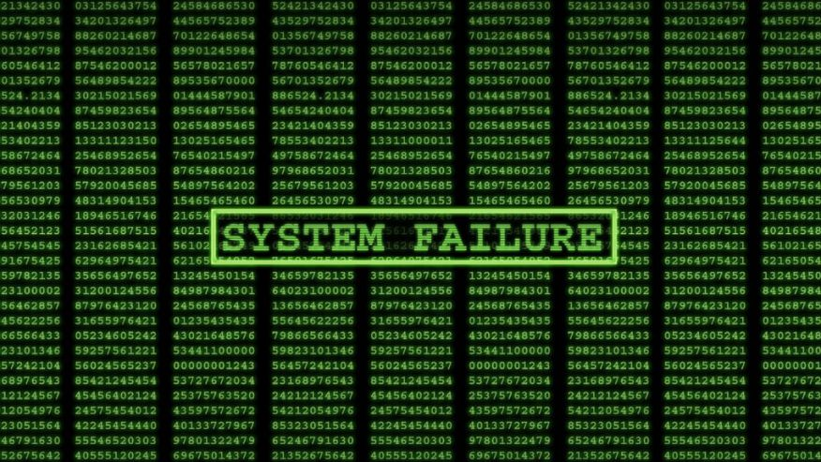


How Java Works
Write Code
Compile
Run

Slide 7



Is that all?
There is also some:
Additional Mambo Jambo like the RUNNING ENVIRONMENT:
Black Vodoo Magic like Process and Memory Management + Running Context
House Keeping like the Garbage Collector

Slide 8
What Java brings
Easy programming – Imperativ Language
Object Oriented Programming
Big Community
Good IDE’s
A lot of libraries
FREE
Manages out of the box thread executions
A lot of implemented algorithms out of the box
Memory security
Cleaning the leftovers
A LOT OF ENTERPRISE JOBS

Slide 9
Object Oriented Programming
Programming was all about logics in the begining and maths
But let’s focus on objects and actions and leave the logic away for a little bit

Slide 10

Imagination exercise
HOW IS THIS MADE?
WHAT CAN IT DO?
It’s the same principle for Objects

Slide 11




Objects & Classes
Turn Left
Turn Right
Accelerate
Brake
Shift
Reverse
Signal
Horn
Frame
Wheels
Methods or
Actions –
they contain the logics
Properties or
What it’s made of
Lights
Doors

Slide 12
Objects & Classes
Now use the car!

Slide 13
Objects & Classes
Class
Object
Instance
An object is an instance of the class. The class describes the objects properties and actions.

Slide 14
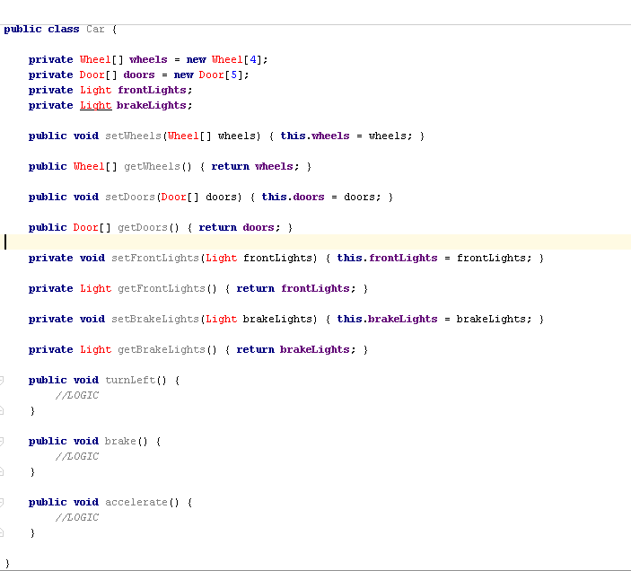
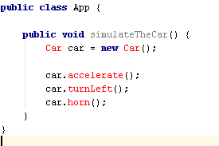
The code
Class to Object

Slide 15


Posibilities of OOP - Inheritence
Although this guy wheres a cape, and he is kind of angry, in his nature he is a man with super powers. So he can do first of all what the man can.
INHERITENCE POWER

Slide 16


Inheritance code
Multiple inheritance is not possible, you can extend only 1 class.
Yet you can implement as many as you like.

Slide 17

Posibilities of OOP - Polymorphism
Override
Polimorphism
Overload

Slide 18
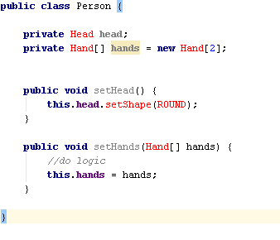
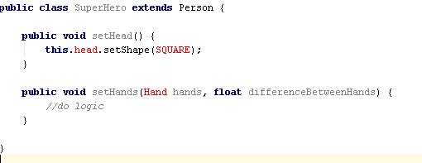
Polimorphism code
Override
Overload

Slide 19
Definitions – good to know
Overriding – you must keep the signature of the method and number of parameters -> all stays the same except for the logic inside the method
Overloading – you can change the number of parameters of an inherited function and/or change the type of the arguments
Never change the signature of the function(the return type) of an inherited function – this will bring up a compilation error.

Slide 20
Class components
Constructor (implicit with no arguments)
Properties
Getters + Setters (good practice)
Methods
Destructor (optional)
Who is this – from inside the methods ?
It’s the refference to the current instance of the class!

Slide 21


Method and variable modifiers
 | Class | Package | SubClass | World
public
protected
default
private

Slide 22
Abstract Classes and Interfaces
Abstract class
Interface
Like a drawing book
Need to extend
Need to implement personal logic – override methods
Can contain usefull methods implemented
Just a skelet
No implementation
Must be implemented
Method declarations and properties
Only public or default (no private or protected)

Slide 23
Design Patterns
Singleton
Factory
Observer
Facade

Slide 24
Collections
HashMap
ArrayList
Vector
LinkedList

Slide 25

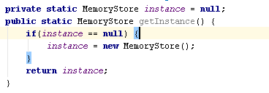
Singleton

Slide 26
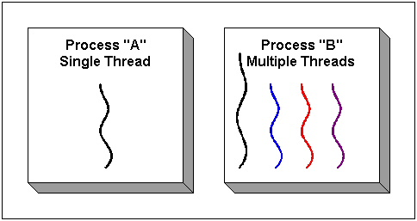
Java RUN
Standalone app – Main Class
Server App – Apache with Framework(optional)
What it does in depth

Slide 27


Maven
Multi purpouse tool:
Packaging tool
Repository tool
Module/project organizer
Plugin browser
Continuos Integration tool
What is it?

Slide 28





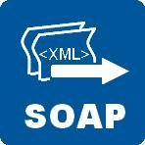
Protocols or just plain all standards
Just going to talk about communication protocols
http://www.domain.tld

Slide 29
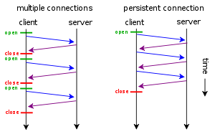
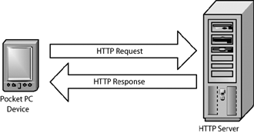
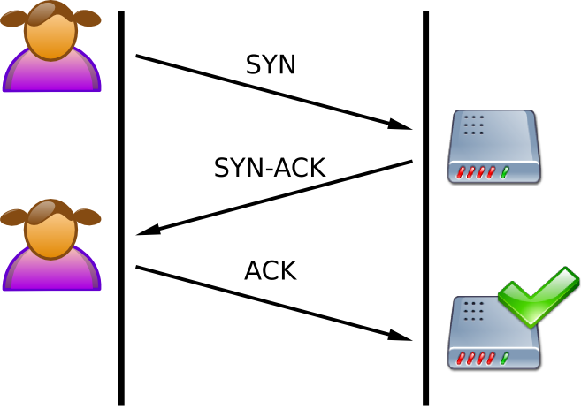
Connections
TCP

Slide 30
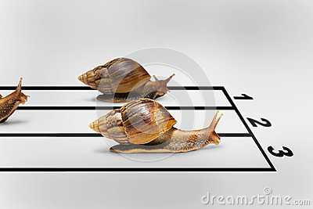
Threads
You can’t control them very well
You never know who gets to the working zone first

Slide 31
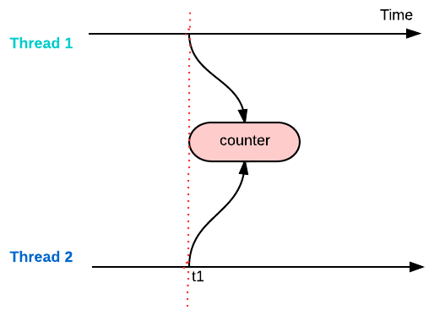
Threads – concerne

Slide 32
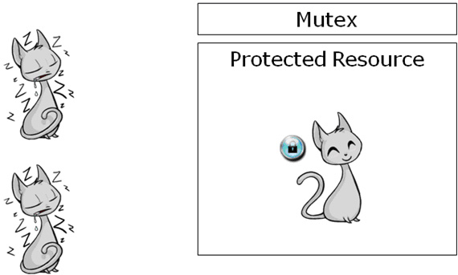
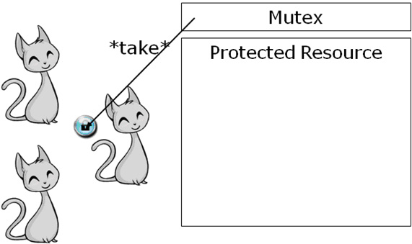
Thread safety

Slide 33
Thread Safety

Slide 34
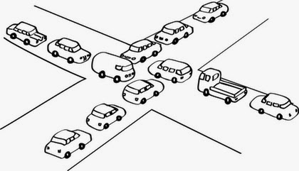
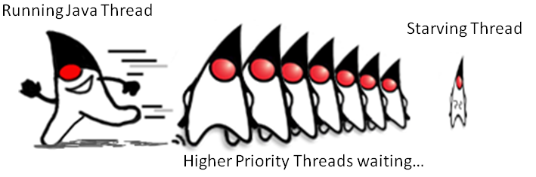
Thread concern – Deadlock or Starvation
Deadlock
Starvation

Slide 35
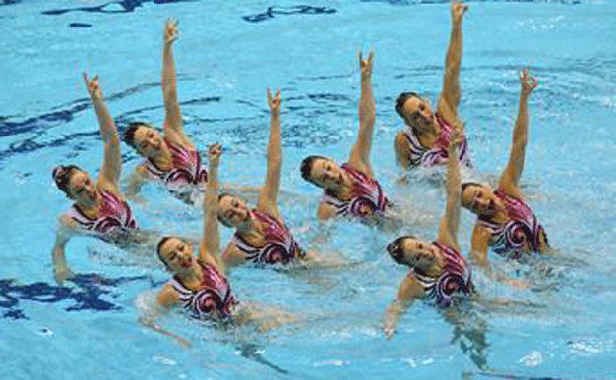
Thread concerns solution
Synchronization

Slide 36

Let’s code

Slide 37
Questions?
Thank you!
GOTO: https://github.com/atrifan/shield_training/blob/training_part1/README.md

